Slide 1
Modelling and validation of wind turbine wake superposition - Using wind farm data
Literature Study
Ottelien Bossuyt
DTU Student nr: s163141 TU Delft Student nr: 4624351

Slide 2
Content
Wake superposition
Wake models
Large Eddy Simulations (LES)
BEACon
Validation
Next steps?

Slide 3
Wake superposition

Slide 4
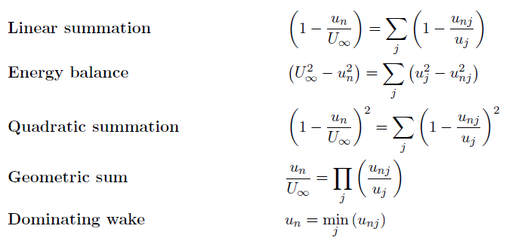

Wake superposition
$u_{n}$: wind speed at wind turbine $n$ $u_{nj}$: wind speed at wind turbine $n$due to the wake of turbine $j$ $U_{∞}$: free stream velocity

Slide 5
Wake models

Slide 6
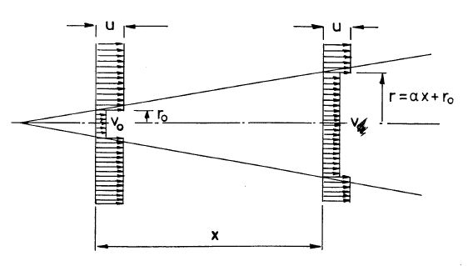
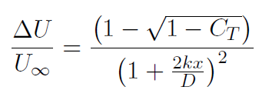
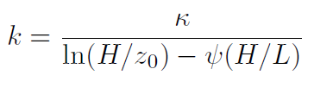

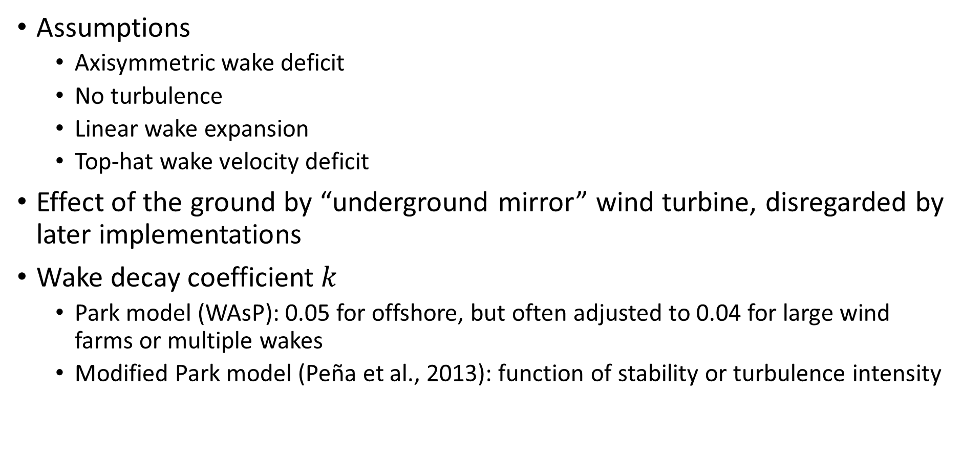
Jensen model
Assumptions
Axisymmetric wake deficit
No turbulence
Linear wake expansion
Top-hat wake velocity deficit
Effect of the ground by “underground mirror” wind turbine, disregarded by later implementations
Wake decay coefficient $k$
Park model (WAsP): 0.05 for offshore, but often adjusted to 0.04 for large wind farms or multiple wakes
Modified Park model (Peña et al., 2013): function of stability or turbulence intensity

Slide 7
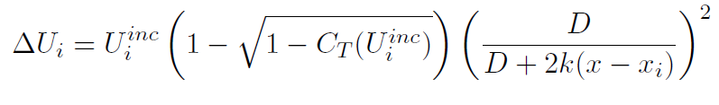
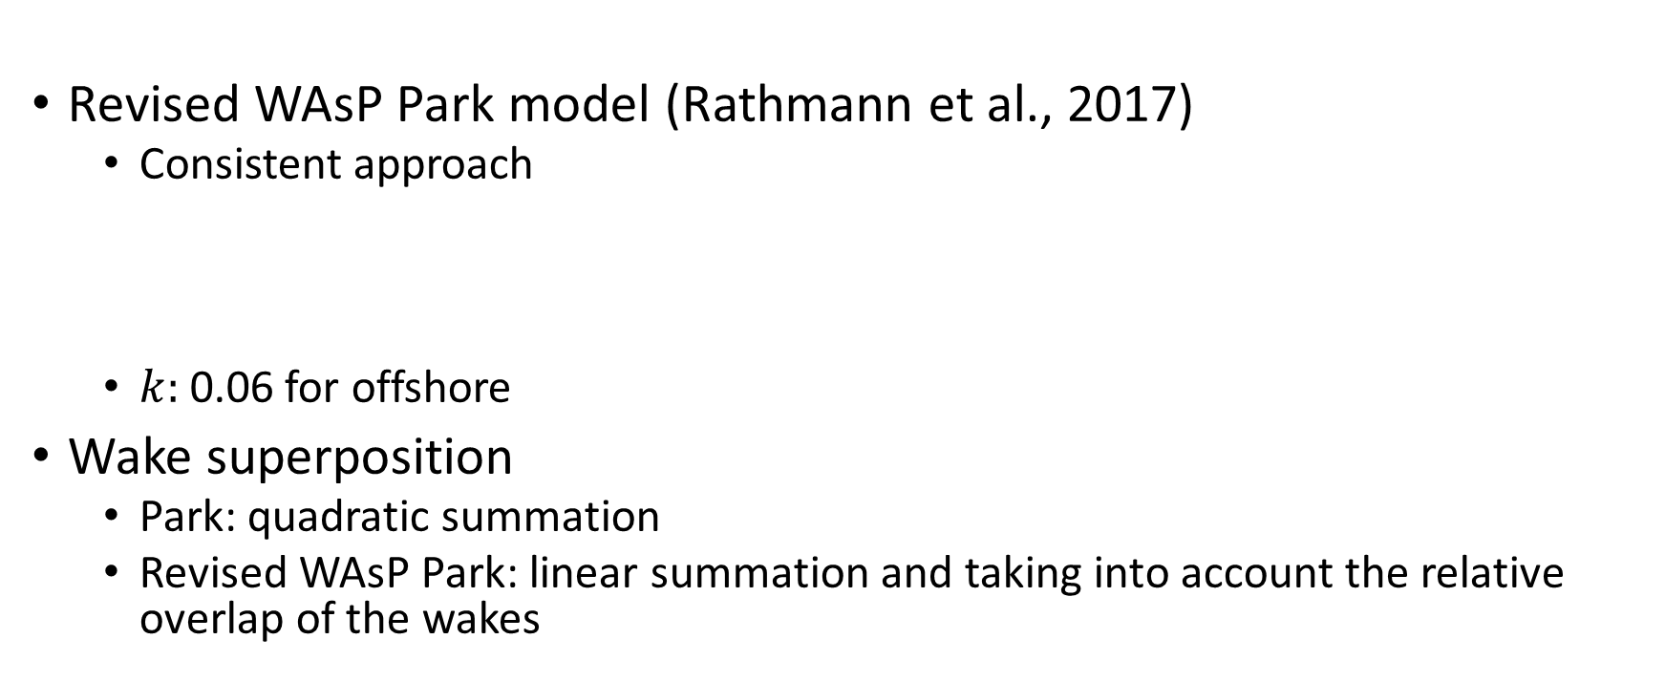
Jensen model
Revised WAsP Park model (Rathmann et al., 2017)
Consistent approach
$k:$0.06 for offshore
Wake superposition
Park: quadratic summation
Revised WAsP Park: linear summation and taking into account the relative overlap of the wakes
A note on wind generator interaction , N. O. Jensen, 1983
A simple model for cluster efficiency, I. Katic, J. Højstrup, and N. O. Jensen. Ewec’86 Proceedings, 1987
Results of wake simulations at the Horns Rev I and Lillgrund wind farms using the modified Park model, A. Peña Diaz, P.-E. Rethore, C. B. Hasager, and K. S. Hansen., 2013.
Validation of the revised WAsP Park model, O. S. Rathmann, B. O. Hansen, J. M. Leon, K. S. Hansen, and N. G. Mortensen. 2017.

Slide 8
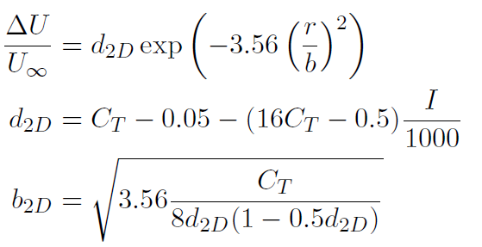
Ainslie model
Assumptions:
Wake is axisymmetric, fully turbulent, stationary in time
Thin shear layer approximation of Navier-Stokes equation
Pressure gradients are no longer dominant at 2D downstream
Gaussian wake deficit profile
Correction for wake meandering
Calculating the flowfield in the wake of wind turbines , J. F. Ainslie. Journal of Wind Engineering and Industrial Aerodynamics, 1987.

Slide 9
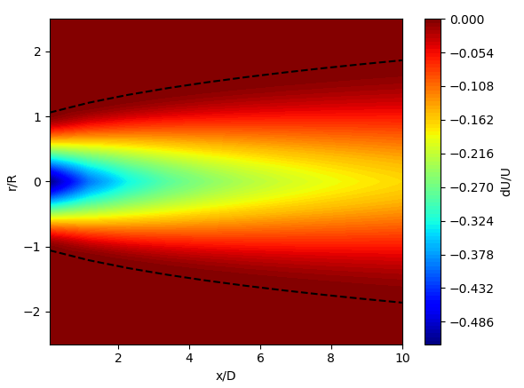

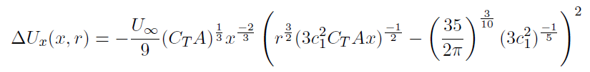

Larsen model
Assumptions
Wake is axisymmetric
Wake is fully turbulent
Axial velocity deficit is zero at the wake boundary
Wake expansion is not linear
Axial wake deficit (1st order)
$x=x_{0}+ ∆x$ $c_{1}$ and $x_{0}$ are a function of $C_{T}$ and $I$
A simple wake calculation procedure , G. C. Larsen, volume 2760. Risø, 1988.
A simple stationary semi-analytical wake model, G. C. Larsen. 2009.

Slide 10
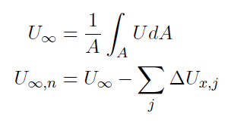
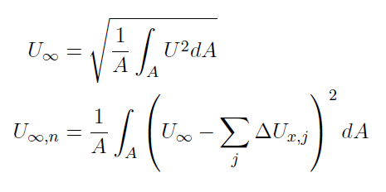
Larsen model
Wake superposition
Linear approach: geometric averaging the inflow wind speed
Non-linear approach: based on momentum balance
A simple wake calculation procedure , G. C. Larsen, volume 2760. Risø, 1988.
A simple stationary semi-analytical wake model, G. C. Larsen. 2009.

Slide 11
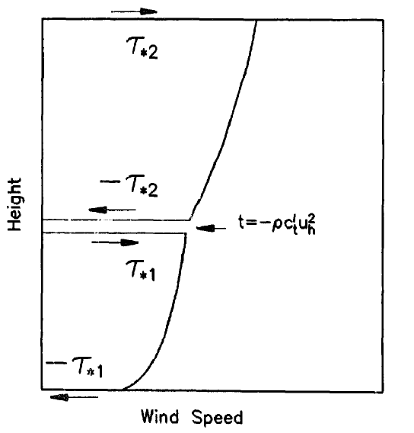
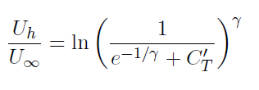
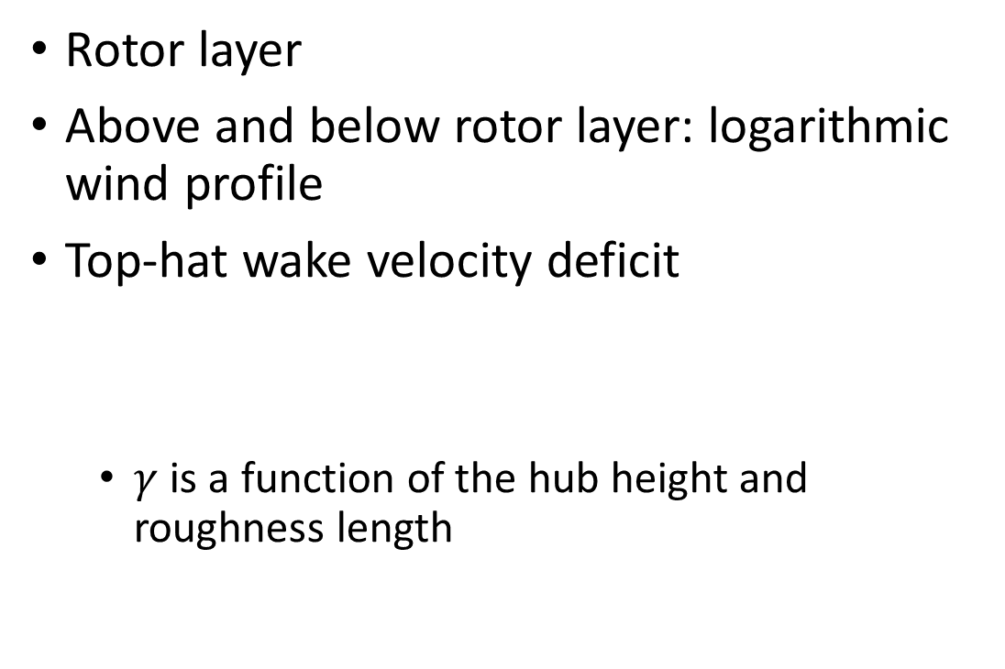
Infinite wind farm boundary layer
Rotor layer
Above and below rotor layer: logarithmic wind profile
Top-hat wake velocity deficit
$γ$ is a function of the hub height and roughness length
On the wind speed reduction in the center of large clusters of wind turbines, S. Frandsen. Wind Energy. Technology and Implementation. Part 1: Papers of the Parallel Sessions, 1992

Slide 12
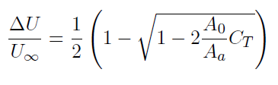
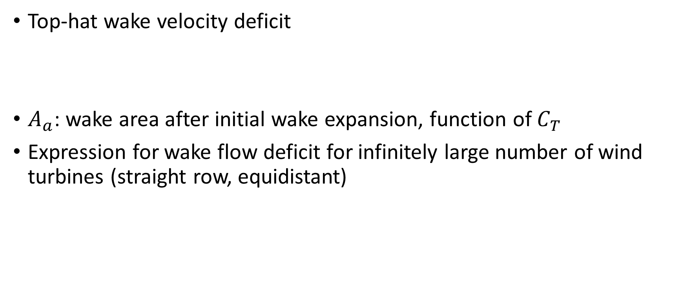
Frandsen model
Top-hat wake velocity deficit
$A_{a}$: wake area after initial wake expansion, function of $C_{T}$
Expression for wake flow deficit for infinitely large number of wind turbines (straight row, equidistant)
Analytical modelling of wind speed deficit in large offshore wind farms, S. Frandsen, R. Barthelmie, S. Pryor, O. Rathmann, S. E. Larsen, J. Højstrup, and M. Thøgersen. Scien-
tic Proceedings, 2004.

Slide 13
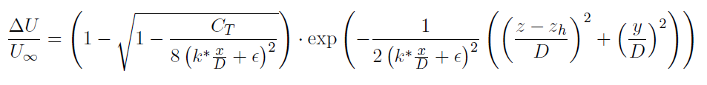
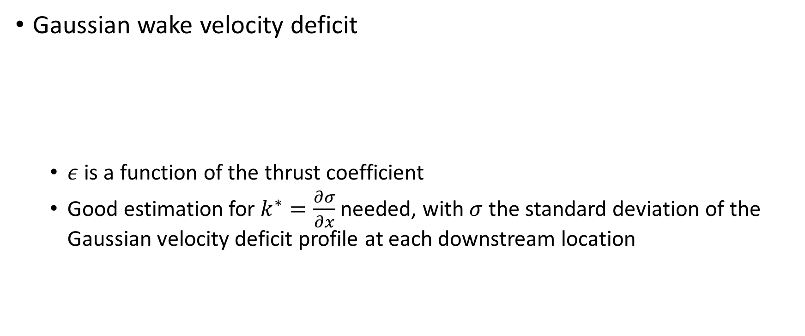
Bastankhah & Porté-Agel
Gaussian wake velocity deficit
$ε$ is a function of the thrust coefficient
Good estimation for $k^{∗}=\frac{∂σ}{∂x}$ needed, with $σ$ the standard deviation of the Gaussian velocity deficit profile at each downstream location
A new analytical model for wind-turbine wakes, M. Bastankhah and F. Porté-Agel, Renewable Energy, 2014.

Slide 14
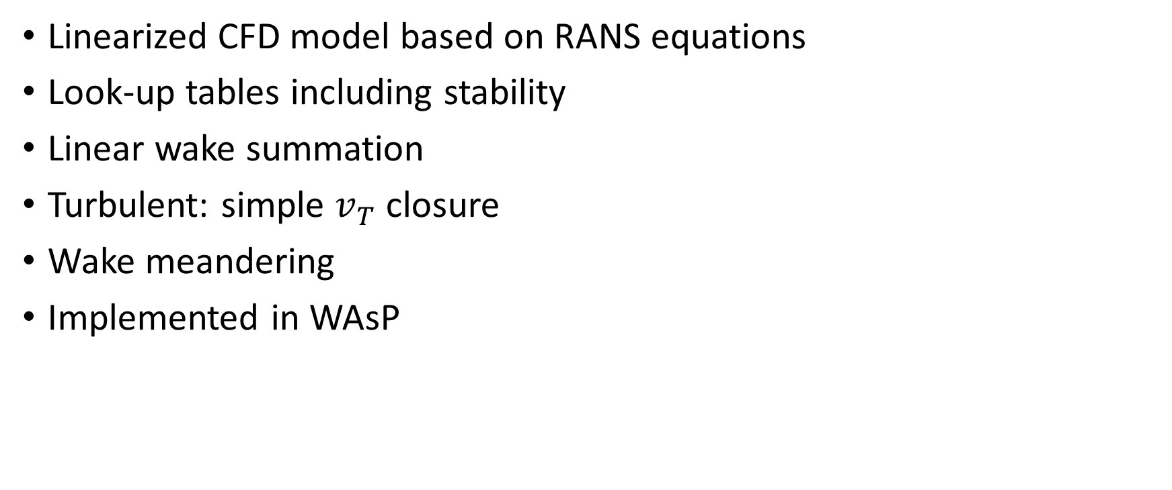
Fuga
Linearized CFD model based on RANS equations
Look-up tables including stability
Linear wake summation
Turbulent: simple $v_{T}$ closure
Wake meandering
Implemented in WAsP
Linearised CFD models for wakes, S. Ott, J. Berg, and M. Nielsen. 2011

Slide 15
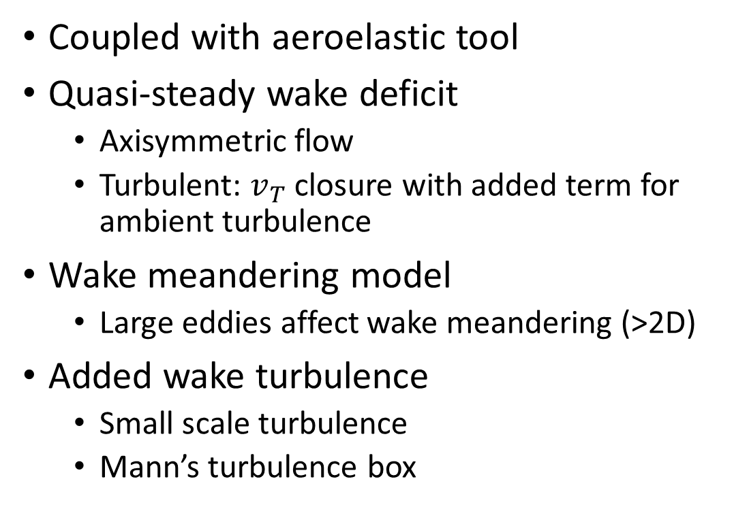
Dynamic Wake Meandering (DWM)
Coupled with aeroelastic tool
Quasi-steady wake deficit
Axisymmetric flow
Turbulent: $v_{T}$ closure with added term for ambient turbulence
Wake meandering model
Large eddies affect wake meandering (>2D)
Added wake turbulence
Small scale turbulence
Mann’s turbulence box
Validation of the standalone implementation of the dynamic wake meandering model for power production, R.-E. H. J. Keck. Wind Energy, 2015
Wake modeling and simulation , G. C. Larsen, H. Aagaard Madsen, T. J. Larsen, N. Troldborg, and T. U. of Denmark. Risø National Lab. for Sustainable Energy. Wind Energy Div. 2008.
Wake meandering – a pragmatic approach, G. C. Larsen, H. Aagaard Madsen, K. Thomsen, and T. J. Larsen. 2006
Dynamic wake meandering modeling, G. C. Larsen, H. Madsen Aagaard, F. Bingl, J. Mann, S. Ott, J. N. Srensen, V. Okulov, N. Troldborg, N. M. Nielsen, K. Thomsen, T. J. Larsen, and R. Mikkelsen. 2007

Slide 16


Dynamic Wake Meandering (DWM)
Standalone DWM (sDWM)
Wake superposition
Different method below and above wind speed?
Below rated wind speed
Above rated wind speed
Validation of the standalone implementation of the dynamic wake meandering model for power production, R.-E. H. J. Keck. Wind Energy, 2015
Wake modeling and simulation , G. C. Larsen, H. Aagaard Madsen, T. J. Larsen, N. Troldborg, and T. U. of Denmark. Risø National Lab. for Sustainable Energy. Wind Energy Div. 2008.
Wake meandering – a pragmatic approach, G. C. Larsen, H. Aagaard Madsen, K. Thomsen, and T. J. Larsen. 2006
Dynamic wake meandering modeling, G. C. Larsen, H. Madsen Aagaard, F. Bingl, J. Mann, S. Ott, J. N. Srensen, V. Okulov, N. Troldborg, N. M. Nielsen, K. Thomsen, T. J. Larsen, and R. Mikkelsen. 2007

Slide 17
Large Eddy Simulations (LES)

Slide 18
Large Eddy Simulation (LES)
EllipSys3D Solver
Equations solved for large scales + sub-grid scale model
Wake behind actuator line model
Mann’s turbulent box
High computational cost
Block structured multigrid solution of 2D and 3D elliptic PDE’s, J. Michelsen, T. U. of Denmark, 1994.
General purpose ow solver applied to flow over hills, N. N. Sørensen, 1995,
Actuator line modeling of wind turbine wakes , N. Troldborg. 2009

Slide 19
BEACon

Slide 20
BEACon
Dual-Doppler radar system
Westermost Rough wind farm, east coast UK
Radial wind speeds combined into 3D Cartesian grid
Extract inflow profile: average inflow in cross-stream direction at each height
N. G. Nygaard, F. E. Brink, J. S. Gretlund, B. Hirth, J. Schroeder, and J. Guynes. Wake measurements in an offshore wind farm using dual-Doppler radars.

Slide 21
Validation

Slide 22
Double wake
Often based on power deficit
Comparison of the results of
A) Validation of the standalone implementation of the dynamic wake meandering model for power production, R.-E. H. J. Keck. Wind Energy, 2015
B) Wind turbine wake models developed at the technical university of denmark: A review, T. Göcmen, P. van der Laan, P.-E. Rethore, A. Peña Diaz, G. C. Larsen, and S. Ott.. Renewable and Sustainable Energy Reviews, 2016.
Notes:
Power deficit: extra uncertainty

Slide 23
Focus on double wake (and power deficit)
Jensen: A) Mostly overprediction B) Big overprediction
Larsen: A) Mostly underprediction, small overprediction when aligned B) Small overprediction
Fuga A) Mostly underprediction, overprediction when aligned B) Very close
sDWM A) Small overprediction
A
B
Validation of the standalone implementation of the dynamic wake meandering model for power production, R.-E. H. J. Keck. Wind Energy, 2015
Wind turbine wake models developed at the technical university of denmark: A review, T. Göcmen, P. van der Laan, P.-E. Rethore, A. Peña Diaz, G. C. Larsen, and S. Ott.. Renewable and Sustainable Energy Reviews, 2016.

Slide 24
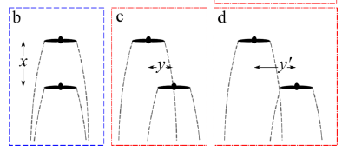
Wake superposition
Limitations to the validity of single wake superposition in wind farm yield assessment K. Gunn, C. Stock-Williams, M. Burke, R. Willden, C. Vogel, W. Hunter, T. Stallard, N. Robinson, and S. R. Schmidt. Journal of Physics: Conference Series
3 cases:
Two inline rotors
Two partly offset rotors
Two fully offset rotors
Notes:
Paper [25]

Slide 25


Two inline rotors
Dominating wake gives the best result
The combined wake is shorter than the single turbine wake: $∆U_{2 rotors}$ 8D behind 2nd rotor < $∆U_{1 rotor}$ 8D behind single rotor
8D
K. Gunn, C. Stock-Williams, M. Burke, R. Willden, C. Vogel, W. Hunter, T. Stallard, N. Robinson, and S. R. Schmidt. Limitations to the validity of single wake superposition in wind farm yield assessment. Journal of Physics: Conference Series

Slide 26
Two partly offset rotors
Dominating wake deficit does not give the best result
Recovery occurs over a long distance
K. Gunn, C. Stock-Williams, M. Burke, R. Willden, C. Vogel, W. Hunter, T. Stallard, N. Robinson, and S. R. Schmidt. Limitations to the validity of single wake superposition in wind farm yield assessment. Journal of Physics: Conference Series

Slide 27
Two fully offset rotors
Wake of upstream wind turbine is shifted due to pressure field of downstream wind turbine
K. Gunn, C. Stock-Williams, M. Burke, R. Willden, C. Vogel, W. Hunter, T. Stallard, N. Robinson, and S. R. Schmidt. Limitations to the validity of single wake superposition in wind farm yield assessment. Journal of Physics: Conference Series

Slide 28
Next steps?

Slide 29
Next steps?
 | LES | Wake models
1. Wake superposition close to rated wind speed | x | x
2. Wake recovery behind second and third turbine | x | x
3. Effect of “gap” in wind farm |  | x
4. Difference between wind turbine at border of wind farm or in the middle of wind farm |  | x
5. Is there a difference in the simulations when only a couple of wind turbines are implemented compared to the implementation of a whole wind farm? |  | x (eg. Fuga)
6. Wake expansion rate | x | x
7. Change in wake upstream wind turbine due to pressure field of downstream wind turbine | x? | x

Slide 30
Wake models available
G.C. Larsen model (2009) (Python, Fortran)
Uses WAsP output files as input
N.O. Jensen model (1983) (Fortran)
Bastankhah & Porté-Agel model (2014) (Fortran)
(Fuga)

